Slide 1

Class 9 - SSH keys and Re-Installation

Slide 2



Slide 3


Slide 4


Slide 5


Slide 6


Slide 7

XSEDE
XSEDE is a single virtual system that scientists can use to interactively share computing resources, data and expertise. People around the world use these resources and services — things like supercomputers, collections of data and new tools — to improve our planet.
Please go to https://www.xsede.org/ and register
After you register, send me your XSEDE ID so I can add you to our project

Slide 8
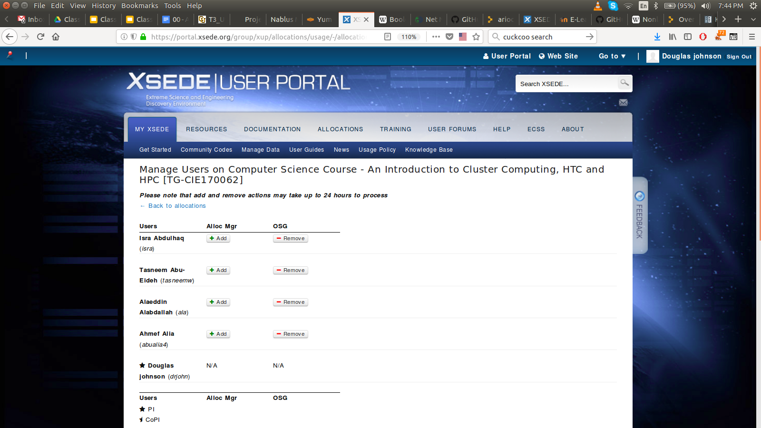

Slide 9
Preparing to use XSEDE
In order to use XSEDE, you have set up your login access. XSEDE uses a multi-factor authentication mechanism.
Follow instructions for setting up your ssh login to login.xsede.org
https://portal.xsede.org/web/xup/single-sign-on-hub
Multi-Factor Authentication - https://portal.xsede.org/mfa
If you have not registered with XSEDE
Please do so soon

Slide 10
The lsb package
The Linux Standard Base (LSB) is a joint project by several Linux distributions under the organizational structure of the Linux Foundation to standardize the software system structure, including the filesystem hierarchy used in the Linux operating system. The LSB is based on the POSIX specification, the Single UNIX Specification (SUS), and several other open standards, but extends them in certain areas.
yum install lsb
Some people had problems with the template for motd.
The reason was that lsb was not installed.
Perhaps the client was installed with incorrect kickstart file?

Slide 11
ssh keys
Secure Shell (SSH) is a cryptographic network protocol for operating network services securely over an unsecured network. The best known example application is for remote login to computer systems by users.
SSH uses a public and private encryption.
User keys are stored in ~/.ssh/ (/home/student/.ssh)
Host keys are stored in /etc/ssh
Familiar use:
student> ssh htc180
student> ssh -l root htc180
student> ssh -l root htc180 hostname
Does not use a permanent client key
Requires entering remote password

Slide 12
Passwordless ssh login
Need to generate client keys:
Generating public/private rsa key pair.
Enter file in which to save the key (/nfs/hepusers/users/reltest/.ssh/id_rsa):
Enter passphrase (empty for no passphrase):
Enter same passphrase again:
Your identification has been saved in /nfs/hepusers/users/reltest/.ssh/id_rsa.
Your public key has been saved in /nfs/hepusers/users/reltest/.ssh/id_rsa.pub.
The key fingerprint is:
ae:a5:34:55:2f:8f:2d:de:b9:91:f4:ce:df:04:03:d8 reltest@coltrane.colorado.edu
The key's randomart image is:
+--[ RSA 2048]----+
| |
| o |
| o E |
| . . . |
| S . o o |
| o * o o |
| o o o = . .|
| . = . o = ..|
| o . +.o.o|
+-----------------+
student> ssh-key -t rsa -b 2048

Slide 13
Passwordless login continued
Install your public in a remote account:
student> ssh-copy-id student@htc191
WARNING: This is a potential security issue. Most computing sites, campuses, etc disable remote access using passwordless ssh
Now try:
student> ssh student@htc191 hostname
Hmm. No password needed

Slide 14
Class 9 Agenda: Date: March 29, 2018 Objective: Finish Puppet Installation Recovering from a crashed system drive
Class 9 Slides: Class 9 - SSH keys and Re-Installation
In-class documentation:
Class 9 - User/Host ssh keys and more
In this class, we start to move away from me providing you with step by step instructions and toward you using what you have learned to solve problems.
It is time for you to start walking by yourself.

